Slide 1

War in Enadia: Happens
Police INC:

Slide 2
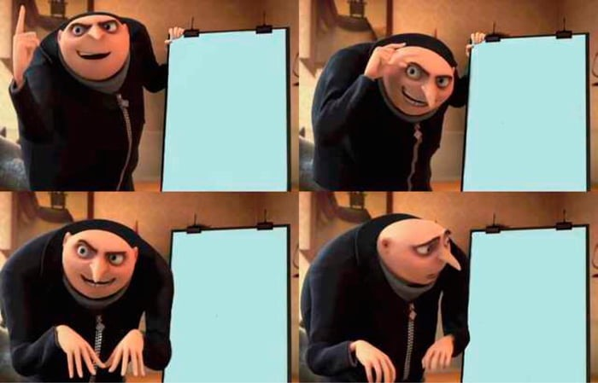
You start a war with MossW
You shoot down the underwater bases they are using to invade
Your cousin starts a rebellion in your home country
Your cousin starts a rebellion in your home country

Slide 3

Enadia: Erupts into war
Niwae:

